Slide 1
WFIS Eurocamp 2023
29th July – 5th August 2023

Slide 2
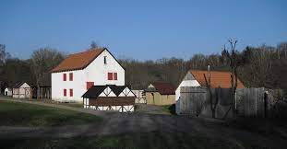
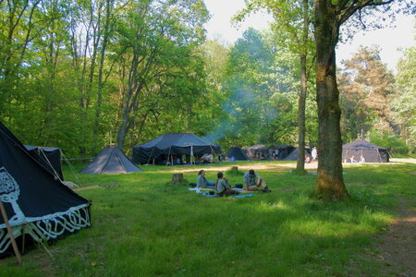
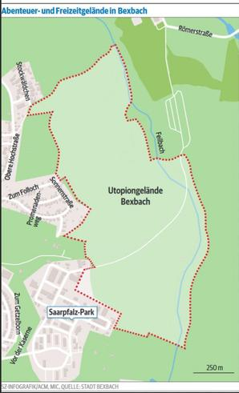
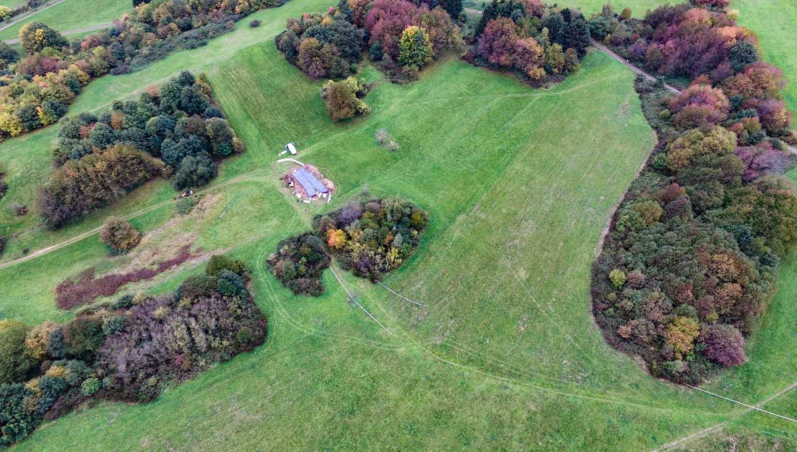
Location
66450 Bexbach – Germany
Saar-Pfalz-Park 128
Coordinates for main gates: 49.3614151; 7.275942

Slide 3
How to arrive AT the Location
Local train station in Bexbach – approximately 2 km to campsite
By car – BAB 6 (Bundesautobahn) – junction 9 (Homburg/Bexbach)
Main train station in Homburg Saar, including high speed train (ICE) – regular public transport to Bexbach
Flixbus to Neunkirchen – public transport to Bexbach
Own bus transport – arrival at camp site with own bus is possible
International airport – Frankfurt Main International – approximately 150 km
Airport Frankfurt Hahn – approximately 120 km
Airport Saarbrücken – approximately 35 km

Slide 4
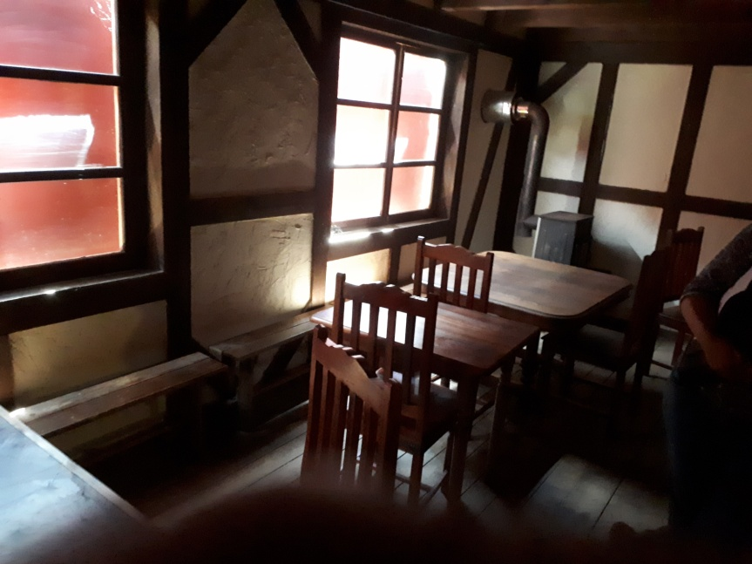
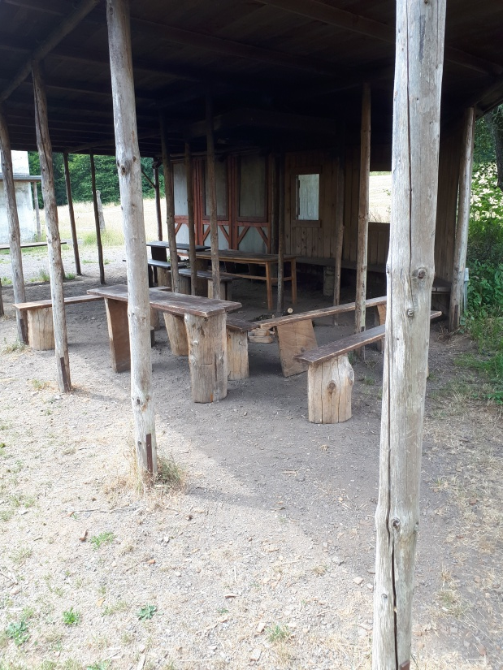
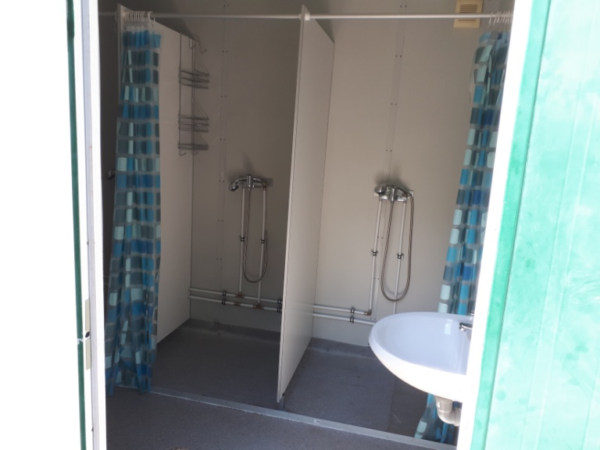
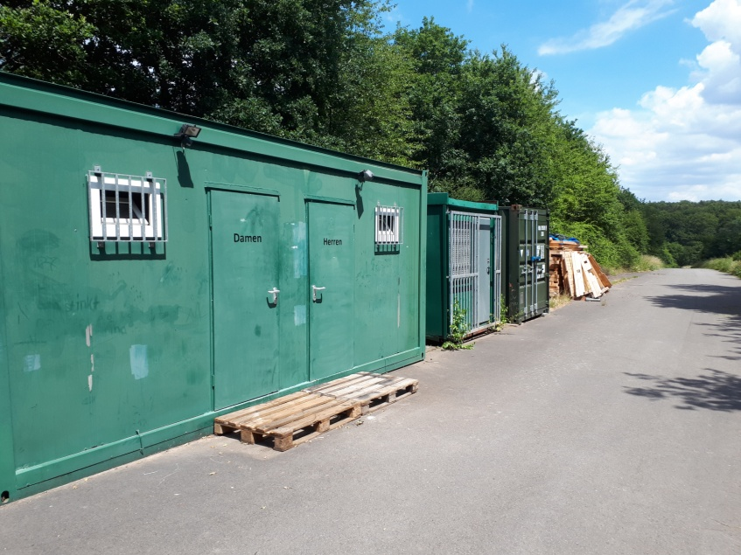
Campsite
Approximately 100 ha
Different sub camps
Meet and greet area
Camp shop
Camp office
First Aid station
Toilet & shower containers

Slide 5
Central Camp Area & Sub Camps
Every Group/Association will set up their own tents
Off the ground fire is allowed in every group´s camp
Showers, toilets and First Aid Station (24/7) are in one central place
Water pick up stations at the sub camps
Self catering and central catering will be possible
Merchandising – T-shirts/polo shirts etc. available
Camp shop with sweets and cold/hot drinks

Slide 6
Campsite - Bexbach
Supermarkets are located in Bexbach (around 1,5 km from campsite)
Public swimming pool close to campsite (200 meters)
Bakers, butchers, pharmacies, doctors and petrol stations in Bexbach
Bank and ATMs located in Bexbach
Ice cream shop, cafe and bakery in Bexbach
Bus and train station in Bexbach
Hospitals are between 5 and 12 km away from campsite

Slide 7
Programme
Saturday 29th July 2023 : Arrival, camp set up, opening ceremony
Sunday 30th July 2023 : Scouts´ Own, activities in sub camp
Monday 31st July 2023 : Hike Scouts/Rovers, Wolf Cub programme
Tuesday 1st August 2023 : Workshops Wolf Cubs, Scouts and Rovers
Wednesday 2nd August 2023 : Day out trips; evening - Scout singing contest
Thursday 3rd August 2023 : Theme day – Wild West theme for all sections
Friday 4th August 2023 : International day/swap day, closing ceremony
Saturday 5th August 2023 : Strike camp

Slide 8
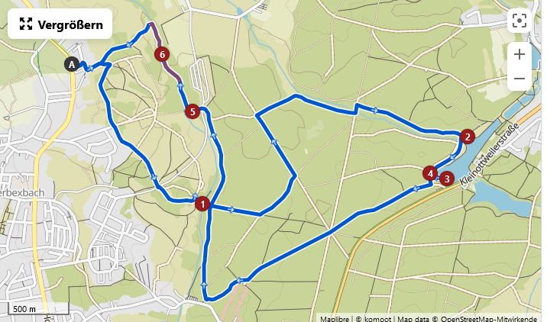
Hike Day
20 different possible hikes around Bexbach
Distance between 5 km and 20 km
Easy and advanced hikes
All hikes are close to the campsite and free

Slide 9
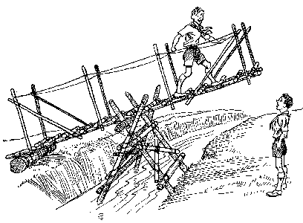
Workshop DAY
Handicraft workshops for all sections

Slide 10
Day Out Activities
Gulliver´s World - Bexbach
Saarländisches Bergbau Museum – Bexbach
GONDWANA - Das Praehistorium – Schiffweiler (10 km from Bexbach)
Schlossberghohlen Homburg (6 km from Bexbach)
Fun Forest AbenteuerPark Homburg – (5 km from Bexbach)
Neunkircher Zoologischer Garten – (5 km from Bexbach)
Burg Kirkel – (6 km from Bexbach)
Römermuseum Schwarzenacker – (8 km from Bexbach)

Slide 11
Theme day
Archery, carpentry/woodwork, knife throwing
Rodeo bull, blacksmith, dig for/wash gold, bank, saloon
Traditional jewellery making and games
Photography with a homemade vintage camera
Driving with diligence (coach), lasso throwing, ropework and knots
Axe throwing, smoke house, grinding knives and axes
Telegraph, tin casting, felting, weaving, knitting
Pow wow, line dancing, country music
Little theatre – story

Slide 12
International and SWAPping Day
Every Association presents its country, culture, food, songs etc.
Swap badges/pins, Scout merchandising

Slide 13
Camp Fees
Camp fee includes:
Stay from Saturday 29th July till Saturday 5th August 2023
All workshops and activities
Firewood
First Aid
Camp fee for self catering: 120 Euros
Camp fee for full catering: estimated at 230 Euros (to be confirmed)
Prices are calculated under current conditions (September 2022)

Slide 14
Registration
Register by the end of November 2022 by Group/Associations including the name of the delegation leader
Numbers of participants: Wolf Cubs/Scouts/Rover/Leaders
Pre stay without catering 5 Euros per night per person (first arrival Wednesday 26th July)
Longer stay without catering until Sunday 6th August 2023 (5 Euros per person)
First payment: 50% of camp fee by 31st January 2023
Second payment: remaining 50% of camp fee by 31st May 2023
E-MAIL: eurocamp_2023@wfis-europe.org

