Slide 1
Skaut ABS
WFIS Workshop Orlovy 2023
15. – 17. 9. 2023
- český skauting ABS
Strana 1

Slide 2
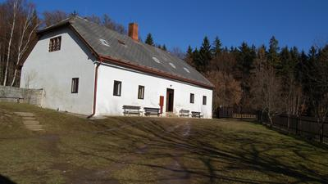
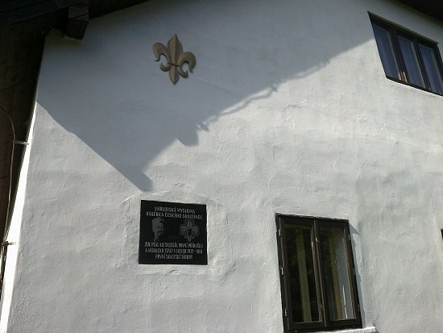
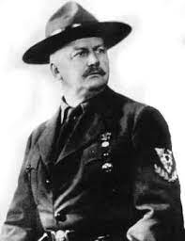
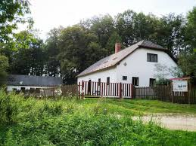
Invitation
WFIS Workshop Orlovy 2023
When: 15. – 17. September 2023
We hope that in future, which is coming, are no pandemic, wars or other disasters of last years. So we are looking forward, that finally we will be able keep all plans.
Where: Czech Republic, lodge Orlovy
This place have real Genius loci for us. Here was „born“ Czech scouting and nearby was held also first Czech scout camp.
- český skauting ABS
WFIS WS Orlovy 2023
Strana 2

Slide 3
How you get to workshop
Exact location: 49.58082330558525, 15.41006815847814
If you would like to arrive by car, you need to reach location 49.58815204949606, 15.415683352924539. If you follow this you will reach point where „road ends“ ;-) Last part of way you have to go through forest, but it is accessible by car and will be marked.
If you will chose another way of transportation. We recommend you use plane to Václav Havel Airport Prague (PRG). From airport is going direct bus to the main train station (Praha hl. n.). From this place you could catch a train to station Světlá nad Sázavou. This will be for you final destination from which will be provide shuttle (also on way back).
Detailed information with recommended connections will be provide at begging of next year.
- český skauting ABS
WFIS WS Orlovy 2023
Strana 3

Slide 4
Accommodation
In building of lodge are beds. In the complex will be also ready tents.
You will need take with you dining utensils, sleeping bag and mat.
Base will be opened at Friday 15. 9. from 15:00.
Meals will be prepared from Friday‘s diner till Sunday‘s breakfast. On request will be prepared package on your way back.
Price: 65 €
Closing ceremony is planed on Sunday 17. 9. at 9:00.
- český skauting ABS
WFIS WS Orlovy 2023
Strana 4

Slide 5
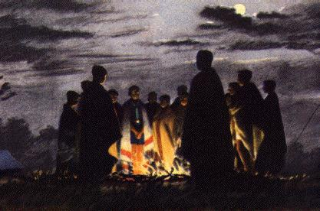
What going to waiting for You
Program
Tee pee construction
Casting of animal tracks
Decorating with leather
Ceremonial camp Fires (preparing torches, etc.)
Wood carving
Trip at place of first Czech scout camp
- český skauting ABS
WFIS WS Orlovy 2023
Strana 5

Slide 6
We are looking forward to You
- český skauting ABS
WFIS WS Orlovy 2023
Strana 6

